Slide 1
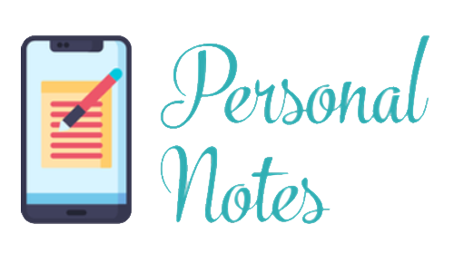
Personal Notes App
Team Name: SS&H Coders
(Shailza, Shivani, & Harpreet)

Slide 2
Technologies
HTML5
CSS3
JavaScript including ES6.
React.
React/Router.
Asp.net MVC.
Entity FrameWork.
MySql Server(phpmyadmin).

Slide 3
Project Report
Did you complete all in-scope tasks?
All features completed that are in- scope of project proposal.
- Users can log in and create accounts.
- Create a note with a date .
- Edit, delete, share, and print a note.
- When closing the browser window the notes will be stored.
- When the user returns, the data will be retrieved.
Did you complete any extra tasks?
No. Did not have enough time to add extra features.
- Export notes to Google Drive(Extra feature).
- Share notes via Email(Extra feature).
- Add reminder to notes(Extra feature).
- Users can attach Picture with Notes(Future Implementation).
- Theme Support (Future Implementation).

Slide 4
Satisfaction Assessment
Does your app solve your problem?
Yes. Use it anywhere on your phone. No hassle to pick up notebook to make quick notes.
Have you or someone else started using the app? What do they think of it so far?
All team members has created account and used the app. It looks useful for daily basis to take quick notes.

Slide 5
Lessons Learned
If you had to build another full-stack CRUD app what lessons would you apply that you have learned from this project?
- Start with mobile design first.
- Include reset.css for every page before starting design.

